Slide 1

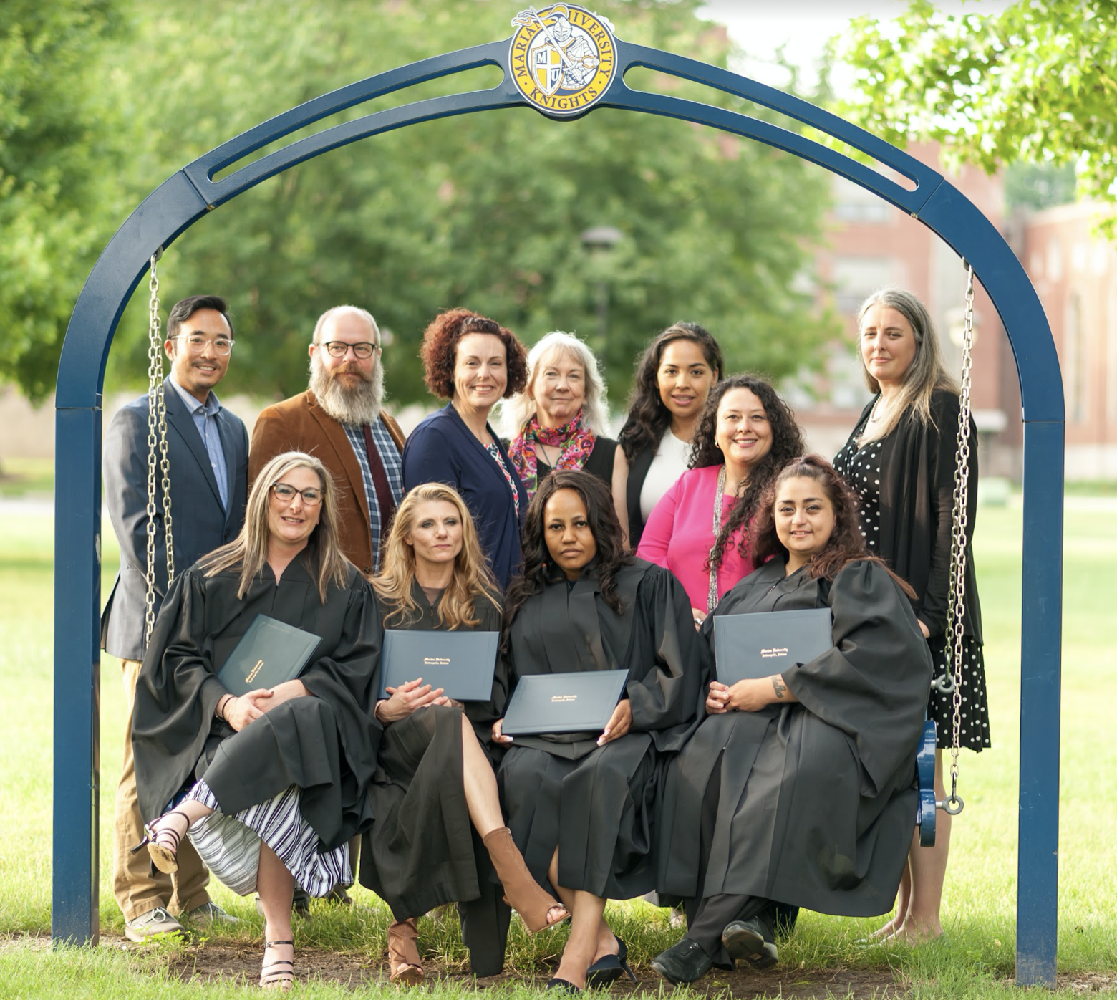
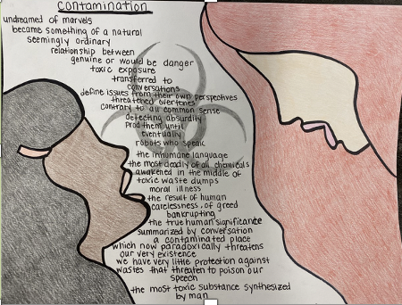
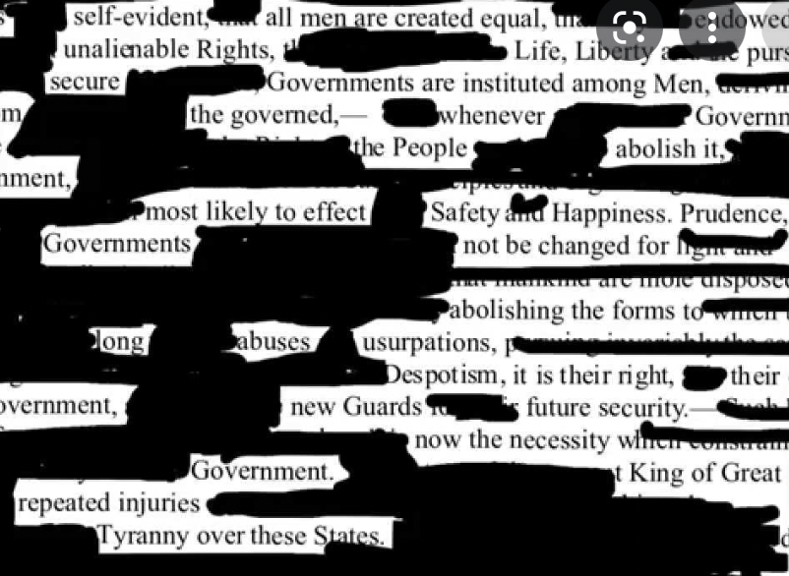
A Partnership in Prison Education
The Marian / Bard Women’s College Partnership
The Bard Prison Initiative began classes in 2001
Program challenges conventional wisdom about incarcerated individuals and outcomes of the criminal justice system; 2.5% recidivism rate for graduates
Marian partnered to offer classes at the Indiana Women’s Prison, Spring 2019
2 cohorts of students now taking classes
Program Director facilitates the process for faculty to teach campus classes at the Indiana Women’s Prison with the same content, innovation, and rigor
The Curriculum
The Women’s College Partnership
Marian Steering Committee oversees and connects the Program Director with key personnel and resources on campus
Students complete the Associates in Liberal Arts
  Specialization: Organizations & Society
  May continue to complete the Bachelors in Liberal Arts
  39 classes have been offered Spring 2019-2022
Scholarships available for students to continue degree at Marian after release
Gender Studies
First Year Seminar
Writing to Learn and Think
Students learn college success skills, how to communicate with 'specificity' in writing & speaking, and how to build community
Sample Assignment: After reading Lois Gibb’s Love Canal, create a work of found poetry that: 1) Captures the power of story and 2) Emphasizes personal / social empowerment
WCP Modification: On campus, students carry out a Story Corp project, interviewing the campus community. WCP students interview each other and read ‘Love Canal’ by Lois Gibbs. Not all students have computer access for typing and adding imagery
Students learn to think critically about gender, race, class, and sexuality as the they pertain to our lived realities
Sample Assignment: Research a selected subject from the major course themes and present findings in the form of a poem, graphic novel, short story, dramatic performance or an artistic rendering
WCP Modification: On campus, students have access to the internet to conduct their research and select their own sources. WCP students complete a Research Request Form that indicates the specific research question they need resources on and the specific kinds of sources they would like to examine. Instructors then work with the program librarian to provide them materials
Students learn academic expectations of writing and practice ways of writing to foster learning, inquiry, and creative problem-solving
Sample Assignment: Within Portfolio 3: The Pursuit of Knowledge, you will produce a research essay that combines narrative and exposition that explores the knowledge you hope to gain as a WCP student, connects this knowledge to a real-world application or personal outcome, and articulates a rationale for why you believe this knowledge is important for yourself and others
WCP Modification: Students use class techniques (poetic inquiry, “writing in the zones,” dialogic notebook) to make connections, deepen understandings, and apply knowledge from other classes. Here, a “learning community” takes on a new level of meaning
Black Out Poetry, a poetic inquiry technique, used to examine the U.S. Declaration of Independence

